Slide 1
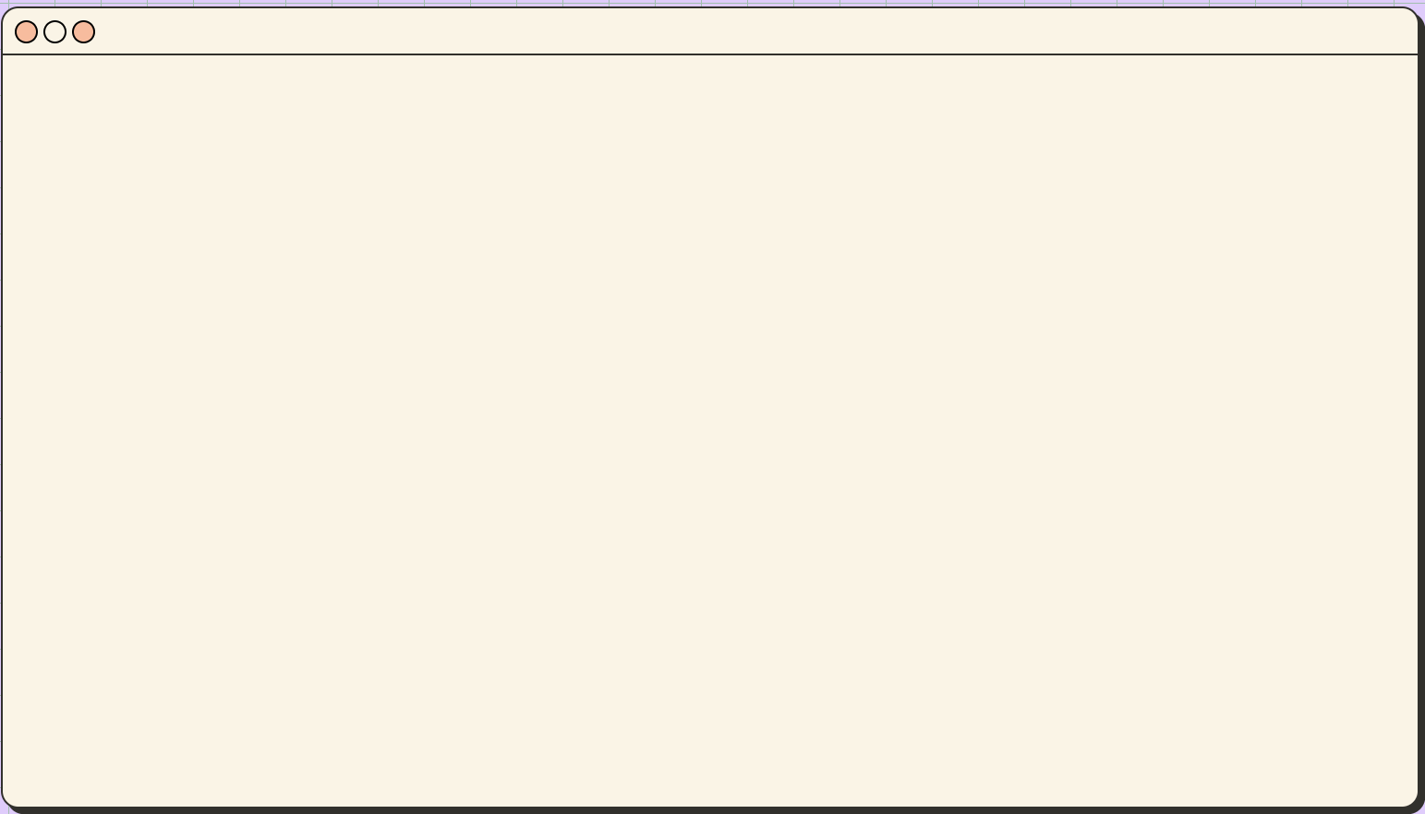

Drone Artificial Intelligence
Traffic Light Recognition

Slide 2
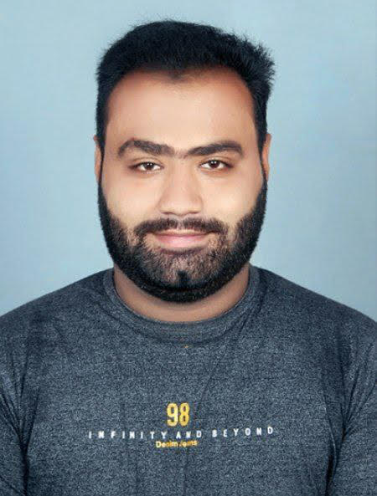
> Whoami
I’m Priyank Basrani
Electronics & Communication Engineer
Having a certificate in Industrial Automation Specialist confirming National Skill Qualification framework level 5
Held first position in PCB designing in Abhyanta 2018 held my OM institute, India

Slide 3

> Whoami
I’m Kirtikumar
Browser & Kernel Hacker
World Record - Youngest Cyber Security Researcher & Ethical Hacker
World Cyber Games 2019 (Asia 7th, World's Top 32) - Seoul, South Korea
Hack-A-Sat 2020 Satellite Hacker
National Representative in BRICS 2020 for India
Google Play Security Research's Top Researcher for 2022
Youngest Tech-Savvy Awardee
Penetration Tester of the Year 2018 in London
Represented India in the High Technology Championship - AI, ML, & Neural Network
Games of Future, Kazan - Competitive Programming Finalist

Slide 4
What we are going to hack for?
Drone Building
Neural Network Making
Network Bridge Interface
Web Interface
Drone Control Panel

Slide 5
Ingredients of the Food?
Drone:
Neural Network:
Clover 4
Skyris Pro
Rasberry Pi 4
Wi-Fi Module
Gyroscope Sensor
ESC
BLDC Motor
Pi Camera
Flight Controller
Tensorflow
OpenCV
Matplotlib
Keras
PyTorch
Numpy
Pandas
Pillow
Plotly

Slide 6
What we are cooking today?
Dataset: Bosch Small Traffic Lights Dataset
Drone: Clover 4
Circuit: Rasberry Pi 4
WebPanel: NodeJS (through FTP – File Transfer Protocol Port 21)

Slide 7
Neural Network:
Dataset refining
Data Preprocessing
Training Model
Percentage calculation
Finding Probability (Between 0 to 1)
Accuracy
Captioning

Slide 8
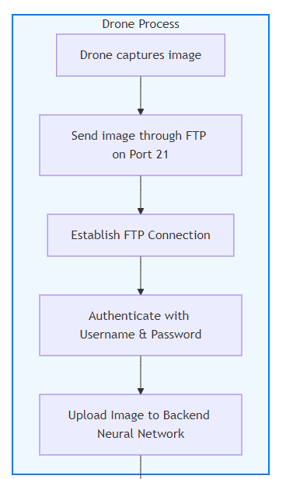
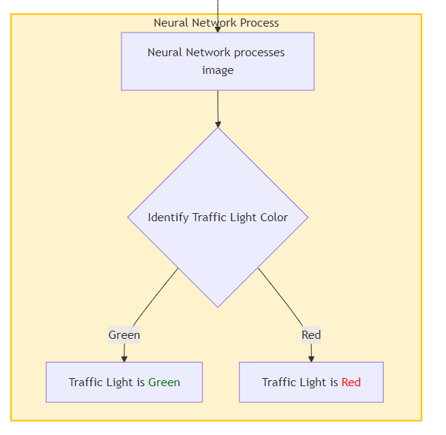
Drone Camera and Neural Network Combination

Slide 9
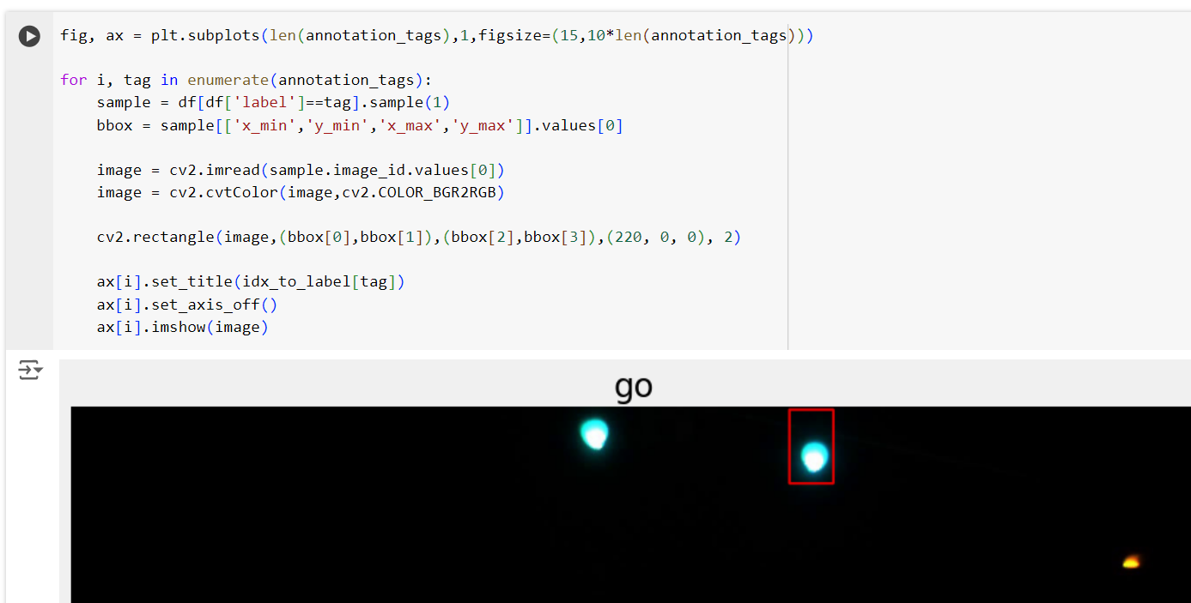
Code Demonstration in action

Slide 10
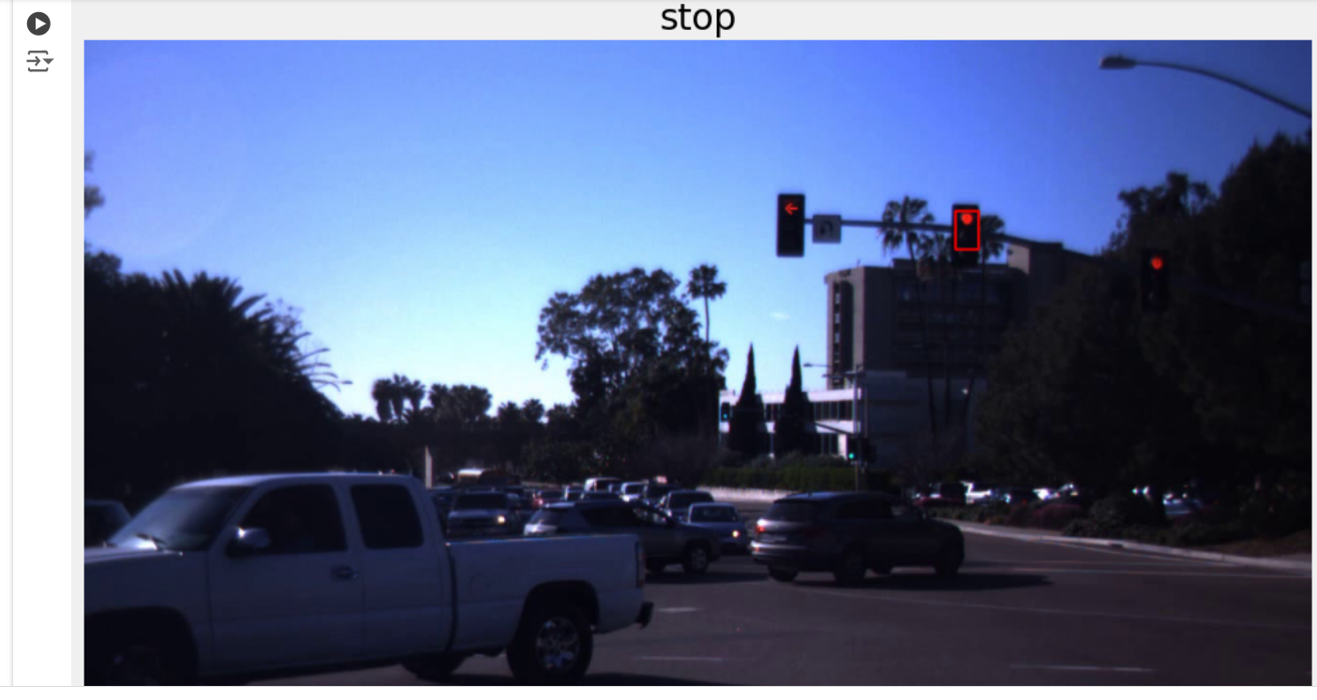
Neural Network with only identification and captioning

Slide 11
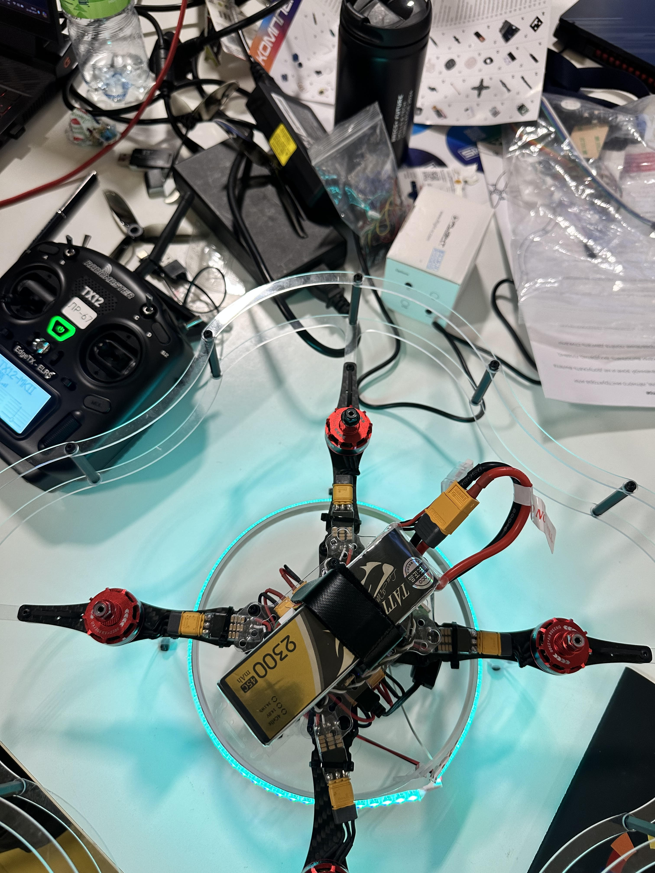
Assembled drone providing connection to FTP through Panel
Autonomous Path
Manual Handling
GPS Dest Part
Path for Obstacle detection

Slide 12
Pro’s for using my Product?
Higher Accuracy
Exceptionally bridged
Real time training
Adjustable
Least memory consumption (~1.4GB)
Least failure

Slide 13
Con’s? Really?
Not loving any older builds/Products
Upgraded machine requirements (For model training purposes only)
Complexity
Lots of training
Huge Datasets
Time investment

Slide 14
Can you overrule your con’s and sell your product to us?
Automation
Better technology
Collection regularly
Real-time training
Compression of data

Slide 15
Real-life question:
Do Aerial system have traffic signals?
Do drones need to follow traffic signals when flying?
Traffic signals are for Ground vehicles and not for the aerial vehicles.
Why we are tackling issue of trafflic light using drones?

Slide 16
Why Drones (Aerial Systems - UAVs for ground signals? Lack of human resources?
Easier Traffic Management. Yes! We build technology to make life easier.
Real time footage of accident incident for tracking situation!
Drones with ability to capture and track down the accused for breaking traffic signals.
Drones are not limited only for detecting and visualizing Traffic signals, they can identify symbols and use LLMs for decision making. Intelligent decision making ability. Pro, yes?

Slide 17
This has caught our attention, can we view your product and decide to grab it?

Slide 18
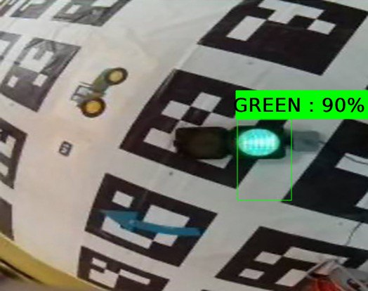
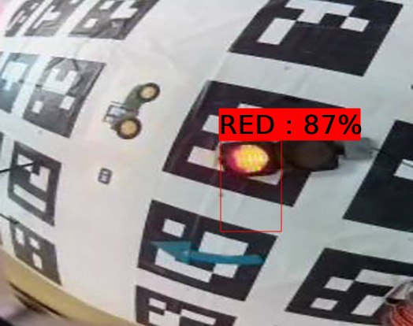
Images captured by drone processed by Neural Network

Slide 19
Can Neural Network only identify from a photo? What if the Neural network wants to do it in real time? Can it recognize from Video?

Slide 20
Let’s innovate the Neural Network and give it a video to identify the data in real time!

Slide 21
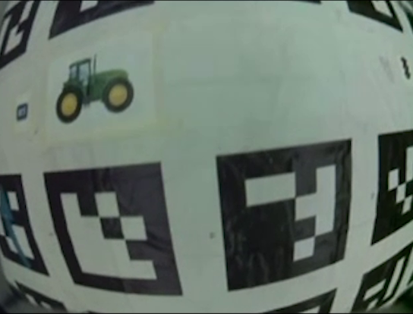

Slide 22
Are you curious about anything related to my product?
Want to talk anything about technology?
Got any exciting idea to implement?
Got any suggestions?

Slide 23
How to get in touch and make life easier with me using tech?
E-mail: kirtiar15502@gmail.com
research@kirtikumarar.com

